Slide 1
Lecture 2, Still Lesson 1: Basics of wave Optics, light sources and interferences
Teacher: Dr. Paul Briard

Slide 2
2.Light sources

Slide 3
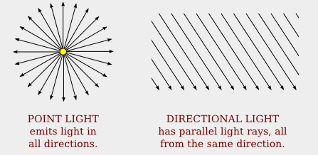
Point light sources
The simplest model of light source is the point light source.
The light is then emitted in all the directions
The wave fronts of the light waves are spherical
http://math.hws.edu/graphicsbook/c4/s1.html

Slide 4
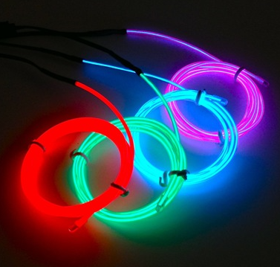
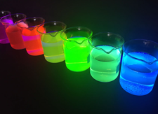
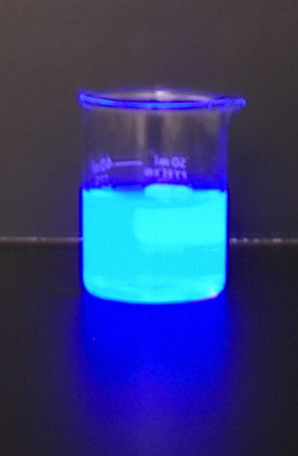
Spontaneous emission of light produced in many ways
Electroluminescence (电致发光 )
Photoluminescence (光致发光 )
Decrire:
electricite dans un tube,
reaction a la Lumiere produit Lumiere d’une autre frequence,
reaction chimique produit lumiere
Fluorescent solutions under UV light
https://glofx.com/product/glofx-electroluminescent-wire/
https://epicscience.net/fluorescence/
Chemiluminescence (化学发光 )
https://www.sciencelabsupplies.com/Chemiluminescence_Kit.html
4
Luminol react with Hydrogen Peroxide

Slide 5



Spontaneous emission of light
An atom which have the energy $E_{2}$
$$E_{2}$$
Excited state
$$E_{1}$$
Ground state or fundamental state
Level of energy

Slide 6


Spontaneous emission of light
$$E_{2}$$
Photon emitted
$$E_{1}$$
The atom have the energy $E_{1}$
Frequency of the light wave
Level of energy
Energy of the photon emitted: $E_{2}−E_{1}=hν$
Planck constant

Slide 7



An atom can also absorb a photon and get energy
Absorption of light by an atom:
$$E_{2}$$
Excited state
A photon incident on an atom
$$E_{1}$$
Ground state
An atom at the level $E_{1}$

Slide 8
Last time, we have seen: Spontaneous emission of light
$$E_{2}$$
Photon emitted
$$E_{1}$$
The atom have the energy $E_{1}$
Frequency of the light wave
Level of energy
Energy of the photon emitted: $E_{2}−E_{1}=hν$
Planck constant

Slide 9



Coherent and incoherent light
The degree of coherence between two waves describe their capacity to interfere together.
We consider two point light sources $S_{1}$ and $S_{2}$ of an extended source of light from which light waves/photons are emitted (in vacuum). Is there coherence of the light emitted in the point P from sources $S_{1}$ and $S_{2}$ ?
P
$$S_{1}$$
$$S_{2}$$
A source of light

Slide 10

Coherent and incoherent light sources
There is coherence between the light emitted from $S_{1}$ and $S_{2}$ at P if they interfere together:
They must have the same frequency
The phase difference between the waves emitted by the sources $S_{1}$ and $S_{2}$ must be constant in respect to the time (if not, they interfere only in an instant t, it is not possible to observe the interferences with a sensor, which integrate the light intensity during a certain duration)
The direction vibration (i.e. the direction of the electric field) must be the same
P
$$S_{1}$$
$$S_{2}$$
But the spontaneous emission of light is a random processes …
An extended source of light

Slide 11

Coherent and incoherent light sources
But, for the case of spontaneous emission:
The frequency of the waves emitted from $S_{1}$ and $S_{2}$ could be different.
The phase different between the waves emitted is not constant (because spontaneous emission is a random processes )
P
$$S_{1}$$
$$S_{2}$$
A source of light

Slide 12


Coherent and incoherent light sources
P
$$S_{1}$$
For an ordinary source of light produced by spontaneous emission, there is no coherence between the light scattered by two points of the source !
$$S_{2}$$
Je peux illustrer en pregnant une Lumiere de la salle ou du soleil
We say that the light by the source produced is not coherent with itself. There is no interference between the light waves which come from two source points of the source.

Slide 13




Coherent and incoherent light sources
P
$$S_{1}$$
And for two or more extended or point sources of light produced by spontaneous emission, there is no coherence between the light scattered by the sources.
Je peux illustrer en pregnant plusieurs Lumiere de la salle et du soleil
$$S_{2}$$
P
$$S_{1}$$
$$S_{2}$$

Slide 14
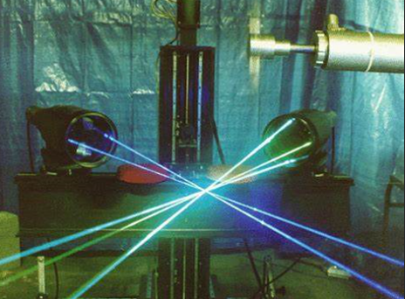
The laser
http://www.newvistaresearch.com/laser-doppler-velocimetry-ldv-phase-doppler-particle-anemometry-pdpa
Laser light used in an experiment

Slide 15



The laser
Laser: “Light amplification by stimulated emission radiation”
The principle of the laser is based on the stimulated emission of light (which is different than the spontaneous emission)
An atom which have the energy $E_{2}$
$$E_{2}$$
A photon incident on the atom
$$E_{1}$$
Level of energy

Slide 16


The laser
Laser: “Light amplification by stimulated emission radiation”
The principle of the laser is based on the stimulated emission of light (which is different than the spontaneous emission)
$$E_{2}$$
$$E_{1}$$
Two photons emitted. They are coherent together and they are coherent with the incident photon.
Level of energy

Slide 17





The laser
Laser: “Light amplification by stimulated emission radiation”
The principle of the laser is based on the stimulated emission of light (which is different than the spontaneous emission)
Another atom which have the energy $E_{2}$
$$E_{2}$$
$$E_{2}$$
$$E_{1}$$
$$E_{2}$$
$$E_{1}$$
$$E_{1}$$
Two photons emitted. They are coherent together and they are coherent with the incident photon.
Level of energy

Slide 18
The laser
Laser: “Light amplification by stimulated emission radiation”
The principle of the laser is based on the stimulated emission of light (which is different than the spontaneous emission)
Another atom which have the energy $E_{2}$
$$E_{2}$$
$$E_{2}$$
$$E_{1}$$
$$E_{2}$$
$$E_{1}$$
$$E_{1}$$
Two photons emitted. They are coherent together and they are coherent with the incident photon.
18
Level of energy

Slide 19
The laser
The explanation given here is very simplified and not complete.
There are more levels of energy involved (at least 3, the number depends to the kind of laser), for a CO2 infrared laser for instance, there is hundred of possible wavelength of light produced (and a device permits to select the wavelength wished at the exit of the laser).
The complete description in a laser is not discussed in this lecture.
!

Slide 20
A superposition of light waves
As the sound you heard at your eardrum is a superposition of SHM of vibrations of different frequencies …
As any electric signal (electric tension or intensity) is a superposition of sinusoidal signals (+ an offset continuous signal) …
Light produced by any source is a superposition of electromagnetic waves with different frequencies.
As far I know there is no source of light which produce a light wave with a single frequency.

Slide 21
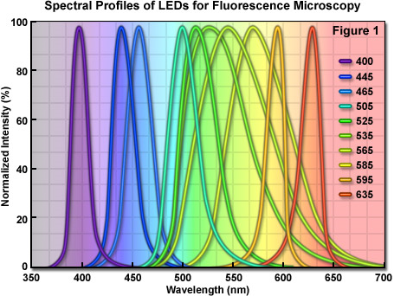
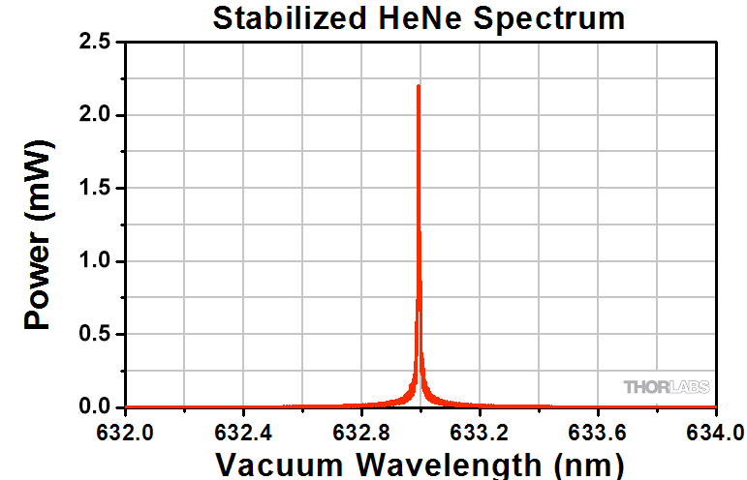
Spectral profile of light
Bien pour introduire la temporal coherence
LEDs (Light-Emitted Diode)
http://zeiss-campus.magnet.fsu.edu/print/lightsources/leds-print.html
The light produced by a laser He-Ne is said “monochromatic” (i.e. a single wavelength), but you can see it is not perfectly monochromatic.
LASER He-Ne
Coherence is also involved with the sharpness of the spectral profile (you will see later details about it). The sharper is the profile, the more coherent is the light.

Slide 22

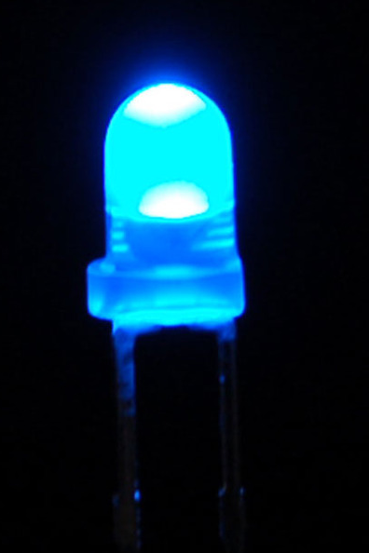
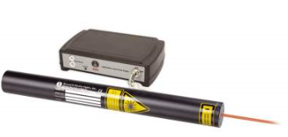
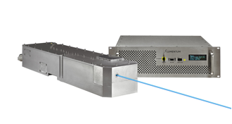
http://blogs.discovermagazine.com/d-brief/2016/01/12/reinventing-the-lightbulb/
https://www.photonicsolutions.co.uk/laserprods.php?cat=lasPSS
http://blogs.discovermagazine.com/d-brief/2016/01/12/reinventing-the-lightbulb/
https://www.adafruit.com/product/780
coherence
Single frequency solid-state lasers
Incandescent bulb
LED
Laser He-Ne
You must understand “single frequency laser” by “ very narrow spectrum linewidth of the light ”, narrowest than for laser such as He-Ne.
[1]“Coherence length of a light emitting diode (led)” by Jeethendra Kumar P K”

Slide 23
To summary: 2 kind of sources/beams
Coherent sources/coherent beams: a coherent source produce a coherent light beam or strictly “light with high degree of coherence”, from which it is easy to produce light interferences, as we will see.
Incoherent sources/incoherent beams: an incoherent source produce an incoherent light beam (a source based on spontaneous emission, for instance), from which it is more difficult to produce light interferences

Slide 24
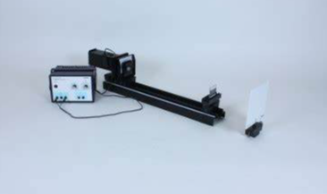
Young experiments
Laser + hole
Double slits (or double holes)
screen
An experiment quite easy to do …

Slide 25
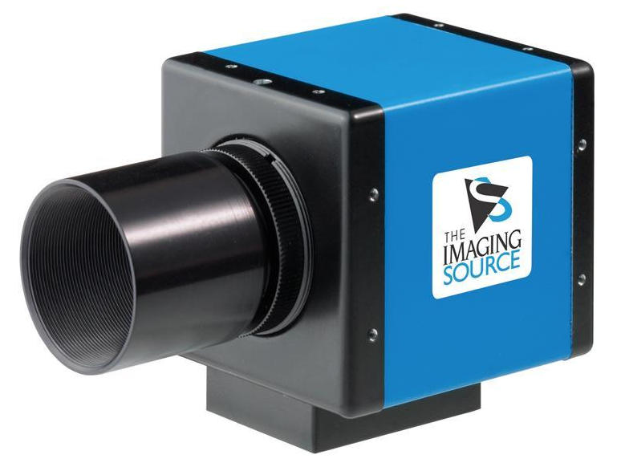


Introduction to Young’s experiments
Any photodetector as a pixel of a camera, for instance, never measure an electric field.
Only the light intensity is measured: The information about the phase of a light wave incident on the is lost!
Electric field of a sinusoidal light plane wave:
$$E\left(r,t\right)=E_{0}\cos{φ(r,t\text{)}}$$
Light intensity:
$$I=\frac{E_{0}^{2}}{2}$$
http://www.astrosurf.com/luxorion/howto-ccd.htm
25

Slide 26
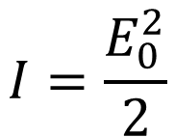


About light intensity
Electric field of a sinusoidal light plane wave:
$$E\left(r,t\right)=E_{0}\cos{φ(r,t\text{)}}$$
$$I=\frac{E_{0}^{2}}{2}$$
Light intensity:
There is not only one definition of the light intensity.
The important thing to remember is “the light intensity is proportional to the square of the electric field amplitude”
$$I∝E_{0}^{2}$$
This statement is right for any definition of the light intensity.

Slide 27

Introduction to Young’s experiments
However, from interferences between waves (coherent together), information about phase of a beam can be recorded.
The intensity of interferences between waves depends to the phase difference between them.
An interference pattern between two coherent waves
http://www.maxicours.com/se/fiche/1/7/410471.html/ts

Slide 28


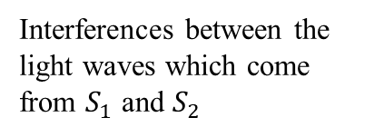

Introduction to the Young’s holes experiment
Create two sources points using pinholes is an easy way to obtain two
$$S_{1}$$
$$S_{0}$$
Interferences between the light waves which come from $S_{1}$ and $S_{2}$
Laser
$$S_{2}$$
Pinhole
Screen
Two Pinholes
The pinholes are like point light sources $S_{1}$ and $S_{2}$coherent between together

Slide 29
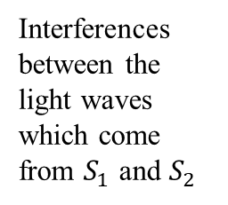



Young’s holes experiment with incident laser light
Interferences between the light waves which come from $S_{1}$ and $S_{2}$
$$S_{1}$$
$$S_{0}$$
Laser
$$S_{2}$$
Pinhole
Screen
Two Pinholes
http://www.maxicours.com/se/fiche/1/7/410471.html/ts

Slide 30

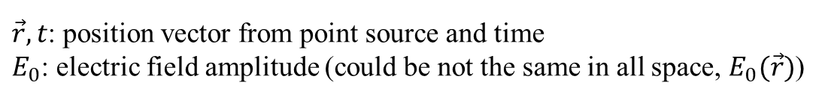

The complex electric field
As for other things in Physics, complex numbers can be useful to describe “real” things.
Considering an electric field magnitude described by:
$$E(\vec{r},t)=E_{0}\cos{(φ\left(\vec{r},t\right))}$$
The complex electric field $\tilde{E}(\vec{r},t)$ is the complex number which $E(\vec{r},t)$ is the real part.
$$\tilde{E}(\vec{r},t)=E_{0}e^{iφ\left(\vec{r},t\right)}$$
$\vec{r},t$: position vector from point source and time
$E_{0}$: electric field amplitude (could be not the same in all space, $E_{0}(\vec{r})$)
Take care that the electric field could be not always a sinusoidal plane wave (for the young hole experiment, it is spherical waves from a hole, considered as ideal point source).

Slide 31

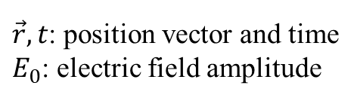


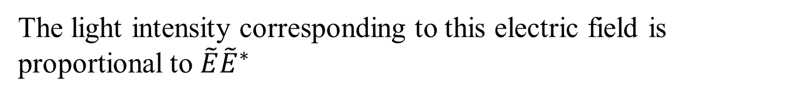
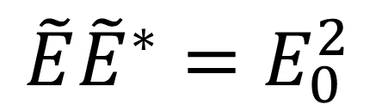

The complex electric field and the intensity
$$\tilde{E}(\vec{r},t)=E_{0}e^{iφ\left(\vec{r},t\right)}$$
Complex conjugated of $\tilde{E}(\vec{r},t)$
$$\tilde{E}{\tilde{E}}^{∗}=E_{0}^{2}$$
$${\tilde{E}}^{∗}(\vec{r},t)=E_{0}e^{−iφ\left(\vec{r},t\right)}$$
The light intensity corresponding to this electric field is proportional to $\tilde{E}{\tilde{E}}^{∗}$
$$I∝\tilde{E}{\tilde{E}}^{∗}$$
There is not only one definition of the light intensity. We will see more details about it later.
$\vec{r},t$: position vector and time
$E_{0}$: electric field amplitude

Slide 32
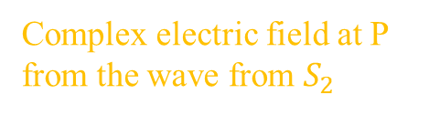




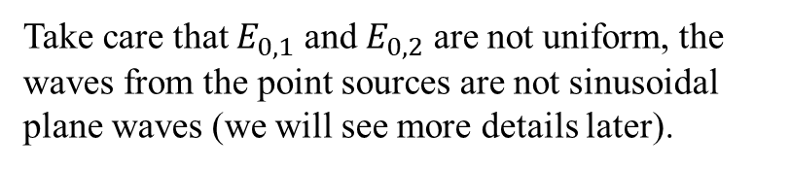

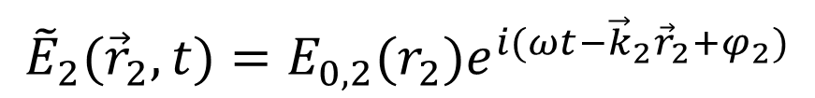

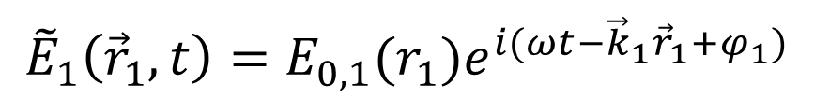
Mathematical description of Young’s holes experiment
Superposition of the two electric fields (total electric field)
$${\tilde{E}}_{tot}={\tilde{E}}_{1}+{\tilde{E}}_{2}$$
$$S_{1}$$
Complex electric field at P from the wave from $S_{1}$
Complex electric field at P from the wave from $S_{2}$
$${\vec{r}}_{1}$$
P
$${\tilde{E}}_{1}\left({\vec{r}}_{1},t\right)=E_{0,1}(r_{1})e^{i(ωt−{\vec{k}}_{1}{\vec{r}}_{1}+φ_{1})}$$
$${\vec{r}}_{2}$$
$$S_{2}$$
$${\tilde{E}}_{2}({\vec{r}}_{2},t)=E_{0,2}(r_{2})e^{i(ωt−{\vec{k}}_{2}{\vec{r}}_{2}+φ_{2})}$$
Screen
P is a point of the screen
Take care that $E_{0,1}$ and $E_{0,2}$ are not uniform, the waves from the point sources are not sinusoidal plane waves (we will see more details later).

Slide 33







Mathematical description of Young’s holes experiment
Superposition of the two electric fields (total electric field)
$${\tilde{E}}_{tot}={\tilde{E}}_{1}+{\tilde{E}}_{2}$$
$$S_{1}$$
Complex electric field at P from the wave from $S_{1}$
Complex electric field at P from the wave from $S_{2}$
$${\vec{r}}_{1}$$
P
$${\tilde{E}}_{1}\left({\vec{r}}_{1},t\right)=E_{0,1}(r_{1})e^{i(ωt−{\vec{k}}_{1}{\vec{r}}_{1}+φ_{1})}$$
$${\vec{r}}_{2}$$
$$S_{2}$$
$${\tilde{E}}_{2}({\vec{r}}_{2},t)=E_{0,2}(r_{2})e^{i(ωt−{\vec{k}}_{2}{\vec{r}}_{2}+φ_{2})}$$
Screen
P is a point of the screen
The light intensity $I$ at P is defined as: ${I_{tot}∝\tilde{E}}_{tot}{{\tilde{E}}_{tot}}^{∗}$
Exercise (5 minutes): Describe the light intensity at P in terms of the characteristics of the both waves when $E_{0,1}≠E_{0,2}$ and $E_{0,1}=E_{0,2}$

Slide 34



Mathematical description of Young’s holes experiment
Superposition of the two electric fields (total electric field)
$${\tilde{E}}_{tot}={\tilde{E}}_{1}+{\tilde{E}}_{2}$$
$$S_{1}$$
Complex electric field at P from the wave from $S_{1}$
Complex electric field at P from the wave from $S_{2}$
$${\vec{r}}_{1}$$
P
The light intensity $I$ at P is defined as: ${I_{tot}∝\tilde{E}}_{tot}{{\tilde{E}}_{tot}}^{∗}$
$${\vec{r}}_{2}$$
$$S_{2}$$
$$I_{tot}∝\left({\tilde{E}}_{1}+{\tilde{E}}_{2}\right){\left({\tilde{E}}_{1}+{\tilde{E}}_{2}\right)}^{∗}$$
Screen
P is a point of the screen
$$I_{tot}∝{\tilde{E}}_{1}{{\tilde{E}}_{1}}^{∗}+{\tilde{E}}_{2}{{\tilde{E}}_{2}}^{∗}+{\tilde{E}}_{1}{{\tilde{E}}_{2}}^{∗}+{\tilde{E}}_{2}{{\tilde{E}}_{1}}^{∗}$$
Symbol “$∗$” means the complex conjugated

Slide 35






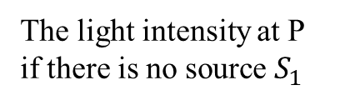
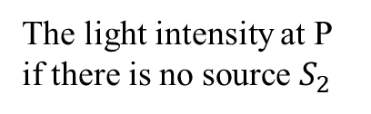

Mathematical description of Young’s holes experiment
Light intensity at P:
$$I_{tot}∝{\tilde{E}}_{1}{{\tilde{E}}_{1}}^{∗}+{\tilde{E}}_{2}{{\tilde{E}}_{2}}^{∗}+{\tilde{E}}_{1}{{\tilde{E}}_{2}}^{∗}+{\tilde{E}}_{2}{{\tilde{E}}_{1}}^{∗}$$
$$I_{tot}∝{\tilde{E}}_{1}{{\tilde{E}}_{1}}^{∗}+{\tilde{E}}_{2}{{\tilde{E}}_{2}}^{∗}+2\left|{\tilde{E}}_{1}\right|\left|{\tilde{E}}_{2}\right|\cos\left(Δφ\right)$$
$$S_{1}$$
$$I_{1}∝{\tilde{E}}_{1}{{\tilde{E}}_{1}}^{∗}$$
$${\vec{r}}_{1}$$
P
$$I_{2}∝{\tilde{E}}_{2}{{\tilde{E}}_{2}}^{∗}$$
The light intensity at P if there is no source $S_{2}$
$${\vec{r}}_{2}$$
The light intensity at P if there is no source $S_{1}$
$$S_{2}$$
Screen
$Δφ$: the phase difference between the two waves at P is:
$$Δφ=\left(−kr_{1}+{kr}_{2}+φ_{1}−φ_{2}\right)$$
P is a point of the screen
Phase at $S_{1}$
Phase at $S_{2}$
$$I_{tot}=I_{1}+I_{2}+2\sqrt{I_{1}I_{2}}\cos{(Δφ)}$$

Slide 36


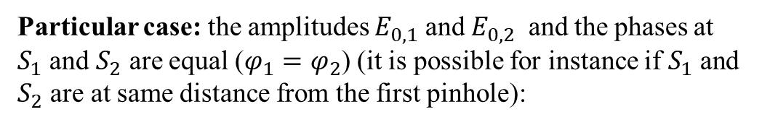













Mathematical description of Young’s holes experiment
$$I_{tot}=I_{1}+I_{2}+2\sqrt{I_{1}I_{2}}\cos{(Δφ)}$$
$$S_{1}$$
$$S_{0}$$
Particular case: the amplitudes $E_{0,1}$ and $E_{0,2}$ and the phases at $S_{1}$ and $S_{2}$ are equal ($φ_{1}=φ_{2}$) (it is possible for instance if $S_{1}$ and $S_{2}$ are at same distance from the first pinhole):
$$S_{2}$$
$$E_{0,1}=E_{0,2}=E_{0}$$
$${\tilde{E}}_{1}{{\tilde{E}}_{1}}^{∗}=E_{0}^{2}$$
$${\tilde{E}}_{2}{{\tilde{E}}_{2}}^{∗}=E_{0}^{2}$$
$$I_{1}∝{\tilde{E}}_{1}{{\tilde{E}}_{1}}^{∗}$$
$$I_{1}=I_{0}$$
where
$$I_{0}∝E_{0}^{2}$$
$$I_{2}∝{\tilde{E}}_{2}{{\tilde{E}}_{2}}^{∗}$$
$$I_{2}=I_{0}$$
$$I_{tot}=2I_{0}+2I_{0}\cos\left(Δφ\right)$$
$$I_{tot}=2I_{0}\left[1+\cos\left(Δφ\right)\right]$$
$$Δφ=\left(−kr_{1}+{kr}_{2}\right)$$

Slide 37









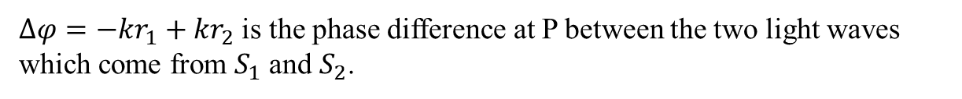
Mathematical description of Young’s holes experiment
$$S_{1}$$
$$r_{1}$$
P
$$I_{tot}=2I_{0}\left[1+\cos\left(Δφ\right)\right]$$
Destructive interferences:
$$\cos{(Δφ)}=−1$$
$$r_{2}$$
$$S_{2}$$
$$I_{tot}=0$$
Constructive interferences:
$$\cos{(Δφ)}=1$$
$$I_{tot}=4I_{0}$$
$Δφ=−kr_{1}+{kr}_{2}$ is the phase difference at P between the two light waves which come from $S_{1}$ and $S_{2}$.
Here is a particular case but there is also constructive and destructive interferences when $E_{0,1}$ $≠E_{0,2}$, $I_{1}$ $≠I_{2}$

Slide 38
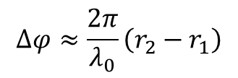


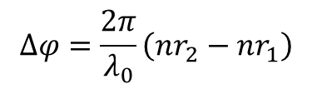


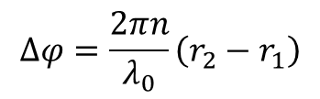

Mathematical description of Young’s holes experiment
$$I_{tot}=I_{1}+I_{2}+2\sqrt{I_{1}I_{2}}\cos{(Δφ)}$$
$$S_{1}$$
If $E_{0,1}=E_{0,2}$, then
$$I_{tot}=2I_{0}\left[1+\cos\left(Δφ\right)\right]$$
$$r_{1}$$
P
And considering the incident wave at $S_{1}$ and $S_{2}$ have same phase:
$$r_{2}$$
$$Δφ=−kr_{1}+{kr}_{2}$$
$$S_{2}$$
$$Δφ=k\left(r_{2}−r_{1}\right)$$
$$Δφ≈\frac{2π}{λ_{0}}\left(r_{2}−r_{1}\right)$$
If the waves propagate through air $\left(n≈1\right)$ :
$$Δφ=\frac{2πn}{λ_{0}}\left(r_{2}−r_{1}\right)$$
If the waves propagate through a medium of refractive index $n≠1$:
$$Δφ=\frac{2π}{λ_{0}}\left(nr_{2}−nr_{1}\right)$$
$nr_{2}−nr_{1}$ is the optical path difference between the two waves which come from $S_{1}$ and $S_{2}$
(in this example, the waves propagates through the same medium of refractive index $n$)

Slide 39
End of wave optics, lecture 2

